Slide 1


Why Can’t I Tell What’s Happening?!?
Stuff That
YOU DO KNOW
You Included
Stuff That
YOU DO NOT KNOW
You Included
Create Audio Classes
Arduino setup()
Arduino loop()
Configure i2s
Interrupt Service Routines
Audio classes update()

Slide 2
How is Audio Processing Triggered in the Teensy?
1
2
//Instantiate Classes
AudioInputI2S i2s_in;
AudioEffectGain gain1;
AudioOutputI2S i2s_out;
AudioConnection patchCords ...
AudioOutputI2S::begin() {
configure_i2s();
configure_dma();
dma.attachInterrupt(isr);
}
3
setup() {
AudioMemory(40);
myTympan.enable();
}
DMA
Whenever the output DMA memory empties, it triggers the ISR
4
AudioOutputI2S::isr() {
copyAudioBufferToDMA();
update_all();
}
loop() {
delay(1000);
Serial.println(“Hello!”);
}
This Happens in the Background
AudioStream::update_all() {
loop over all audio classes {
eachClass.update();
}

Slide 3
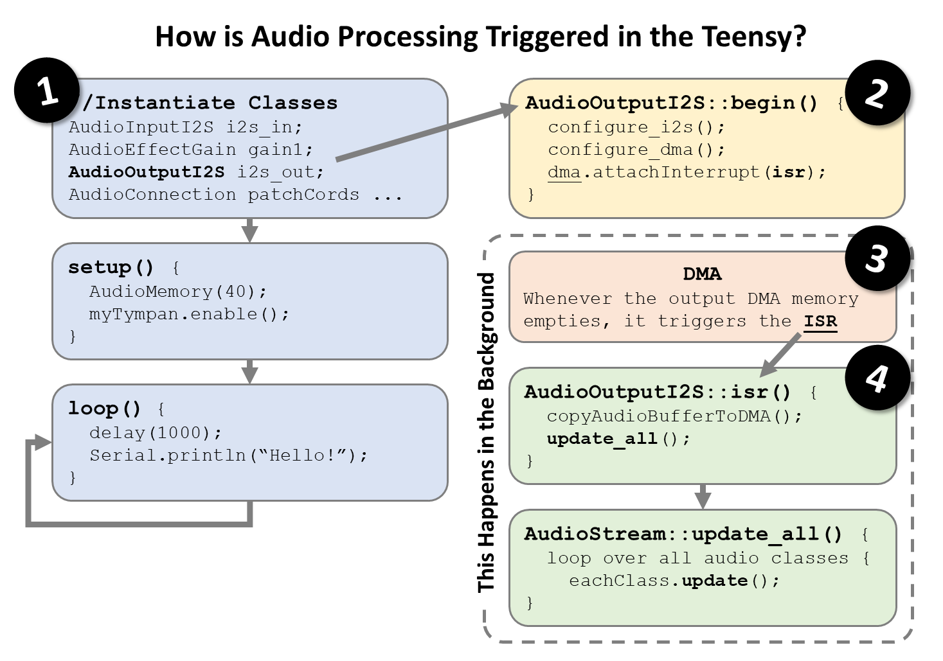

Slide 4
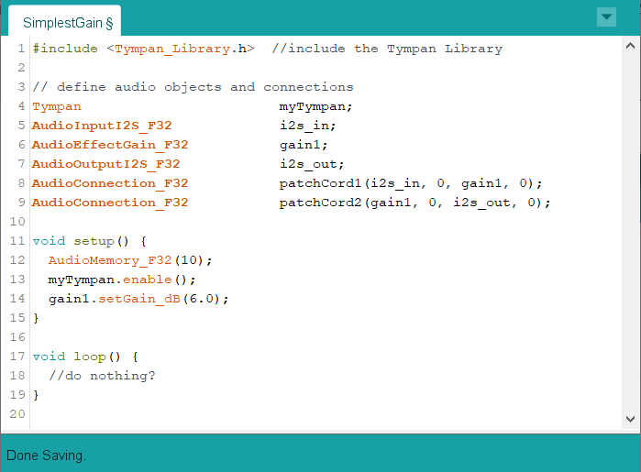
But this sketch does nothing!
How does “gain1” get called?!?

Slide 5
